Slide 1
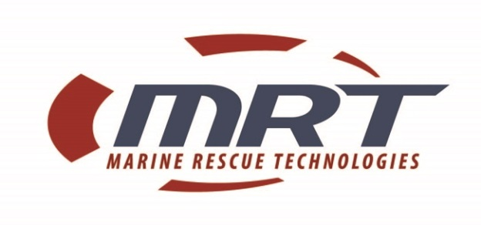
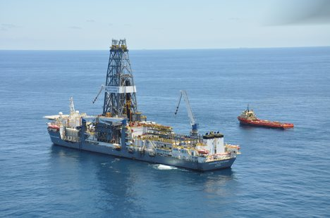
Capabilities
Presentation
Marine Rescue Technologies
May 14, 2014

Slide 2
Marine Rescue Technologies (MRT)
Based in Sebastian, FL, in 1993
Master Distributor in the America’s & Worldwide
  Network of 259 Distributors and resellers worldwide
  Key End users
    Transocean, EXON Mobil, Chevron, PEMEX, Shell, Husky
    US Navy, United States Coast Guard, ACOE, US Army
    Canadian Navy, Canadian Coast Guard,
    Disney, Royal Caribbean Cruise lines
    National Parks, Homeland Security, Marine Training Schools

Slide 3
MRT Product Focus
Non Mandatory (Approved) Products
  Maritime Survivor Locating Devices
    Alerts, PLB, & receivers
  Retrieval (Rescue)nets, cradles & rafts
  Automated Personnel on Board (POB)
  Automated Muster Systems
Approved Products (see catalog)
  Life rafts, SOLAS life vests
  SAR alerts, EPIRBs, PLB’s, ELTs, etc.

Slide 4
Associations
RCTM, The Royal Technical Commission for Marine Services, http://rtcm.org/
USMSA, United States Marine Safety Association, http://www.usmsa.org/
DEMA, Divers Equipment Manufacturers Association, http://www.dema.org/

Slide 5
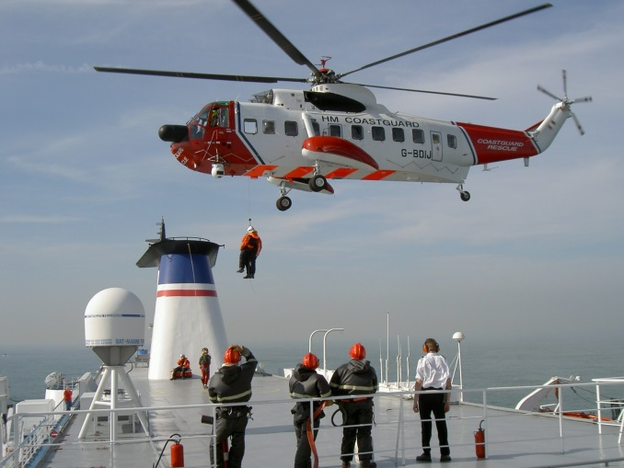
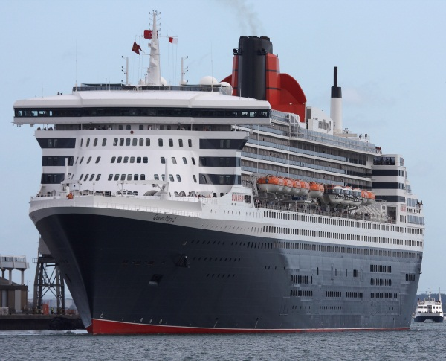
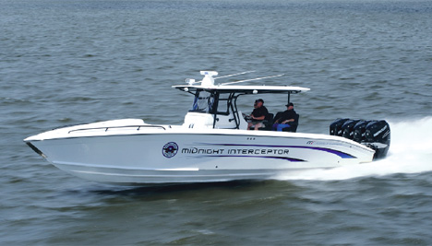
Vertical Markets
Oil & Gas Industry
  Rigs, supply vessels, Helicopter Transit
Commercial Marine
  Pilots boats, barges, tugs, dive boats
SAR, Coast Guard, Navy
Shipping
  Cruise Ships, SOLAS Vessels
Brown water
  Jetties, wharf’s, fast rescue vessels

Slide 6
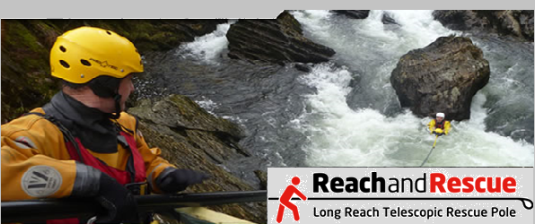
Solutions
Reach & Rescue Products

Slide 7
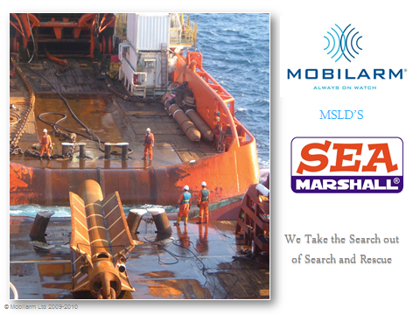
Maritime Survivor Locating Devices

Slide 8
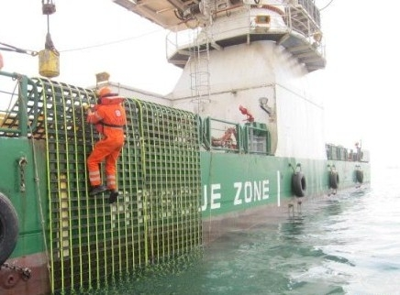
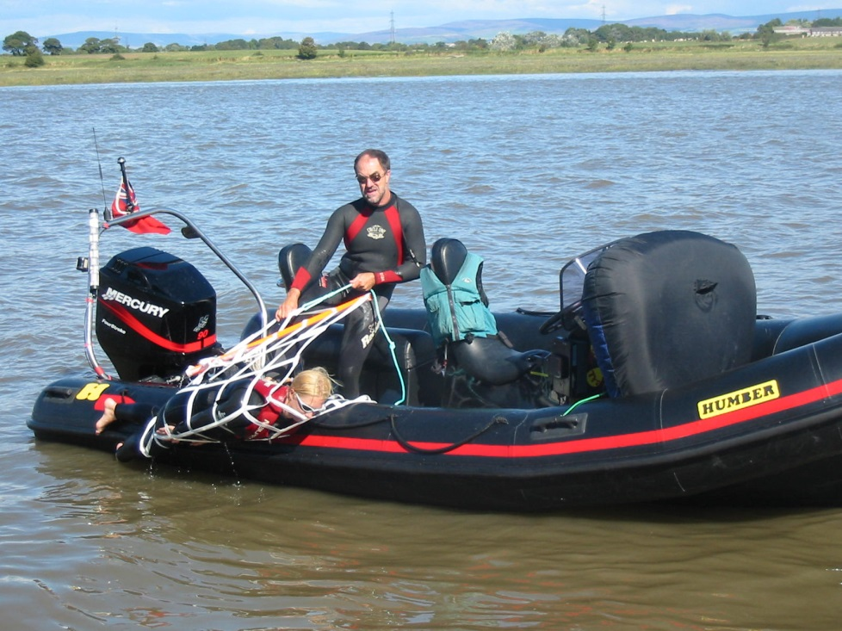
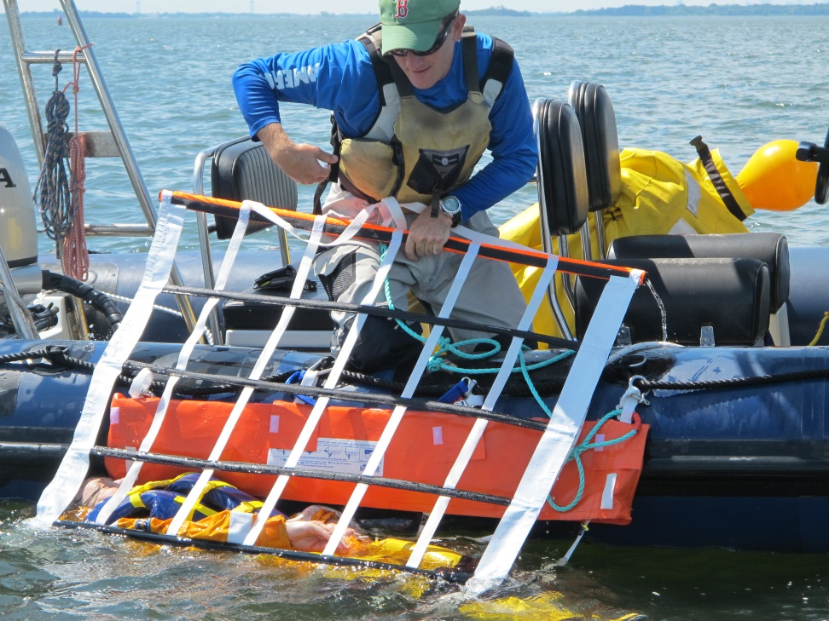
Retrieval Systems, Rescue Nets, Cradles, etc.
Jason’s Cradle
Markus Rescue Systems

Slide 9
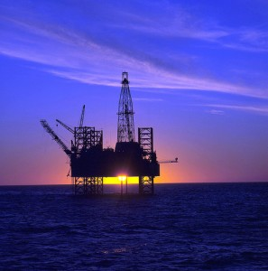

AutoCrew Management System
Modules Include
  Personnel on board
  Automated Muster
  Safety Meeting attendance
  Jobsite tracking
  Area Control
  Training Certificate Management
Key focus is oil rigs, OSV’s Crew boats & Plants

Slide 10

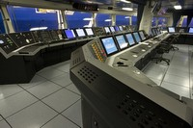
Benefits – AutoCrew
Easy to install, use and maintain
  Std. IP addressable devices
  Managed by an SQL database
Automated POB System
  Eliminates use of flight manifest
  No grease pencil or boards
Real time operational awareness
  To muster officers
  To Bridge
  To 1st responders

Slide 11
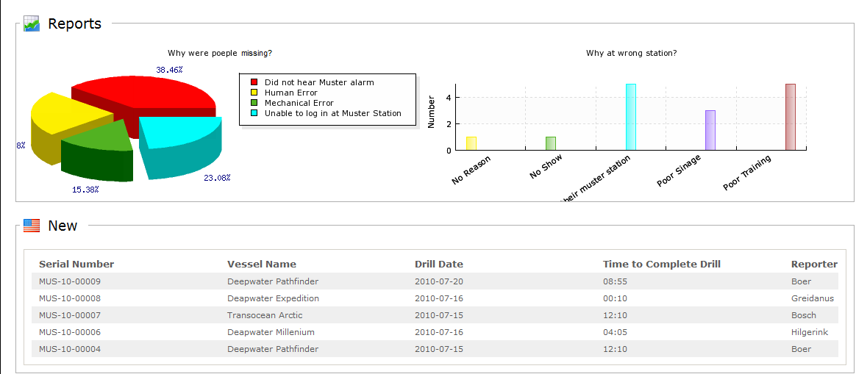
Benefits – AutoCrew (acms)
Increase emergency response
Automated reports, (exportable), enterprise level
Improves safety record and competitive edge!
ROI – saves time and lives

Slide 12
Summary – MRT Capabilities
Proven record with start-up technologies
Existing customer base
  Distributors
  Resellers
  End Users & references
Experienced - We know this market
  Dedicate resources to succeed

Slide 13
Summary - Territory
186 Resellers in the United States & Canada
  East Coast & West Coast
National & International Companies (Customers)
  EXXON, Consolidated Grain and Barge, Chevron, Shell
  Suncor, Husky Oil, Foss Marine, Mansion Construction,
  American and Canadian Pilots Association
Government Customers (East & West Coast)
  Army Corps of Engineers, US Navy, US Coast Guard
  Canadian Navy, Canadian Coast Guard
  National Oceanic and Atmospheric Administration (NOAA)

Slide 14
Summary - Territory
Vertical Markets (East & West Coast)
  Fisheries
  Government agencies
  Brown water
    Pilots, tug & barge companies
  Public safety (police, fire, SAR)
  Port authorities
  Construction companies
    Bridge Construction
    Dredging

Slide 15
Promotion & Trade Shows
Direct
  Keen on end user trials that are documented
  Selling back into existing end user and reseller base
  Agents & Partners with end user contacts
Indirect
  Trade Shows (National)
    International Work Boat Show
    Offshore Technology Conference (OTC)
    Pacific Marine Expo
    Miami or Lauderdale Boat Show

